Slide 1


Cyberbullying Detection
By:
John Hani
Mohamed Nashaat
Mostafa Ahmed
Zeyad Emad (Team Leader)
Under supervision of :
Dr. Eslam Amer
Eng. Menna Gamil

Slide 2

Agenda
Introduction
Related work
Problem Statement
System overview
Project Deliverables

Slide 3
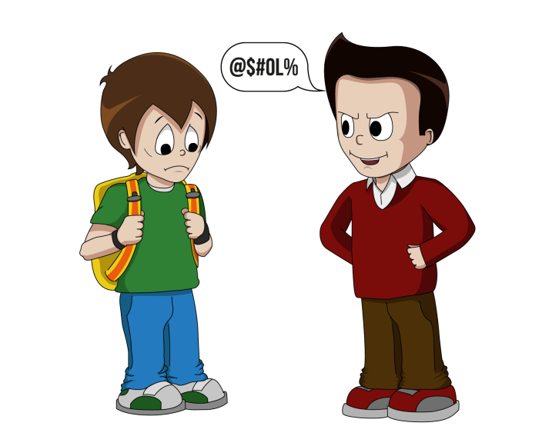


Introduction
Use superior strength or influence to intimidate someone

Slide 4
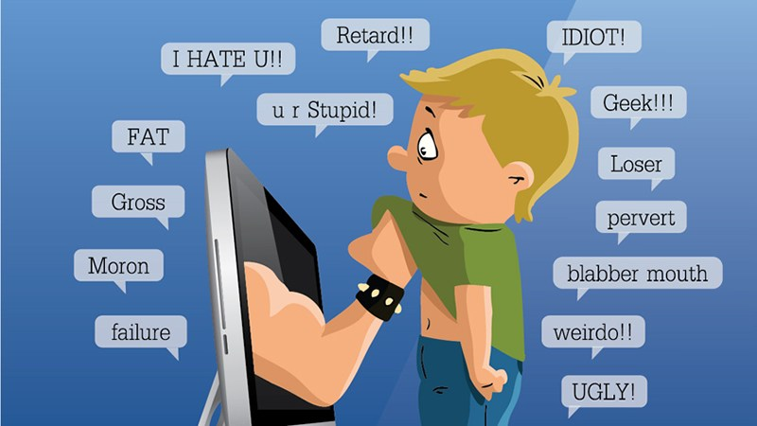
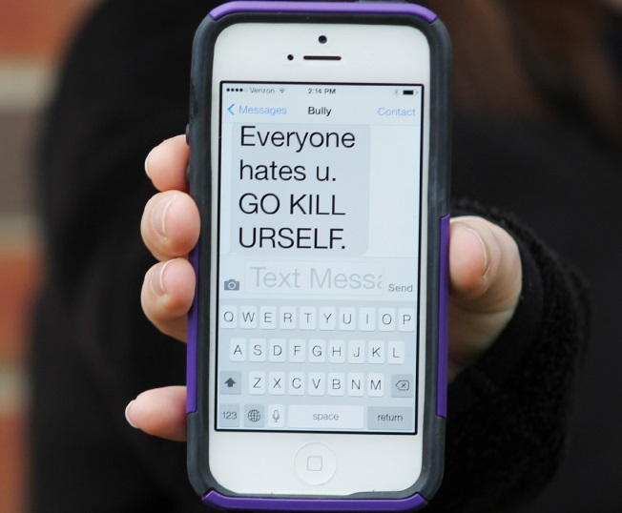
Introduction Cont.
Cyberbullying has been manifesting our youth for quite sometime, due to them being involved in one form of social media communication or another.
Sarcasm which the use of irony to mock or
convey contempt.
More than 1 in 3 young people have experienced
cyber threats online.
Over 25 percent of adolescents and teens have been
bullied repeatedly through their cell phones or the Internet.
National Crime Prevention Council, “Cyberbullying”
i-SAFE Inc., “Cyber Bullying: Statistics and Tips”
Richard Webster, Harford County Examiner, “From cyber bullying to sexting: What on your kids’ cell?”

Slide 5
Related Work
Experts and Machines Against Bullies: A Hybrid Approach
to Detect Cyberbullies
Main Problem
They focused on the detection of bully users in online social networks and the efficiency of both expert systems and machine learning models for identifying the potential bully users.
Contribution
They used three machine learning methods: a Naive Bayes classiﬁer, a classiﬁer based on decision trees and Support Vector Machines (SVM) with a linear kernel
Precision
The discrimination capacity of the MCES was 0.72

Slide 6
Related Work Cont.
Machine Learning Approach for Detection of Cyber-Aggressive
Comments by Peers on Social Media Network
Main Problem
They are trying to binary classify comments as bullying or non-bullying.
Contribution
Pre-Processing: Normalization like: removing unwanted strings and correcting words.
Features: N-gram , TF-IDF , occurrence of pronouns , Skip-gram
Classifiers: Support Vector Machine (SVM) , Logistic Regression
Precision
70.0% using SVM
64.0% using logistic regression
Vikas S Chavan and Shylaja S S

Slide 7
Related Work Cont.
A Pattern-Based Approach for Sarcasm Detection on Twitter
Main Problem
It’s hard for humans to detect sarcasm. Therefore, recognizing sarcastic statements can be very useful to improve automatic sentiment analysis of data.
Contribution
-They proposed efficient way to detect sarcastic tweets to improve sentiment analysis.
-They used NLP like: tokenisation, lemmatization, etc.
-They used SVM for classification.
Results
Accuracy 83.1%
Precision 91.1%
MONDHER BOUAZIZI AND TOMOAKI OTSUKI

Slide 8
Problem Statement
In previous cyberbullying detection frameworks there has been a problem in detecting false positive cyberbullied cases.
The accuracy in these papers is not high enough and could be improved.
Sarcasm which is type of cyberbulling is not detected in these papers.

Slide 9
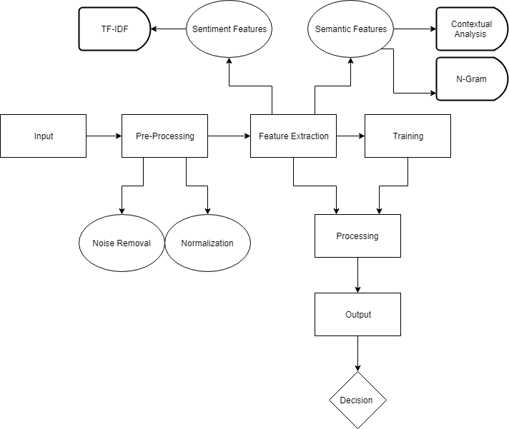
Overview diagram

Slide 10
Pre-processing text
This is a grea test \n message
Stemming
[Thi , is , a , grea , test , \n , message]
Lemitization
[Thi , is , a , grea , test , \n , message]
Auto Correct
[This , is , a , great , test , \n , message]
Remove Encoding
[this , is , a , test , message]
Notes:
<number>

Slide 11
Feature extraction
Sentiment Features
TF-IDF
Linguistic Inquiry and Word Count (LIWC)
Capturing second person pronoun

Slide 12
Processing
Classifiers
SVM
Random Forest
According to the Accuracy , embed Deep Learning Methods

Slide 13
Demo

Slide 14
Any Questions?

Slide 15
Questions related to (Experts and Machines Against Bullies: A Hybrid
Approach to Detect Cyberbullies)
Multi-Criteria Evaluation Systems (MCES): *made by 12 experts*
Four-point scale ‘Unlikely’, ‘Less likely’, ‘Likely’ and ‘Very likely’ corresponding to
values 0.125, 0.375, 0.625 and 0.875 respectively. The 'I don't know' option was also
available.
The importance was indicated on a four-point scale of 1: not informative, 2: partially informative, 3: informative and 4: very informative.
The ratio of capital letters in a comment.
The number of emoticons. The occurrence of a second person pronoun followed by a profane word in profanity. The term frequency–inverse document frequency (Tf-Idf).
H1: Using the outcome of the MCES as an extra feature for training the machine learning models. Results, features’ categories and profanity – misspelling .
H2: Using the results of the machine learning model as a new criterion for the expert system by assigning equal weights.
(Decision Tree bad, SVM better, Naïve Bayes best)

Slide 16
Questions related to (Machine Learning Approach for Detection of Cyber-Aggressive Comments by Peers on Social Media Network)
What is N-grams?
N-grams are a group of continuous sequence of n-items from a given text. These are used for dividing text and words into n chunks known as N-grams. Example: “You are funny” its unigram will be “you”,”are”,”funny”.They used 2, 3, 4 and 5 N-grams for the building feature vector.
What is TF-IDF Score?
TF-IDF stands for "Term Frequency, Inverse Document Frequency". It is a way to evaluate the importance of words in a document based on how frequently they appear across various documents. The score signifies the importance of that term in relation to the original training data.
What is Logistic Regression?
This algorithms provides probabilistic approach to data. The outcome are probabilities modeled as a function of predicted variables, using a logistic function given below. Also it’s a binary classifier. p=1/(1+e-)

Slide 17
Questions related to (A Pattern-Based Approach for Sarcasm Detection on Twitter)
What is F1 score?
F1=2*(precision*recall/precision+recall)
What is Accuracy?
It represents the overall correctness of classification.
What is Precision?
It represents the fraction of retrieved objects(eg: sarcastic tweets) that are relevant.
What is Recall?
It represents the fraction of relevant objects that are retrieved.
Tools used in NLP:
Apache OpenNLP
Gate Twitter part- of-speech tagger

